Slide 1


LIBERTY ELECTRONICS.
We serve the best
GROUP
FALCULTY DATA
MUHAMMAD SHAHEER Std1401788
SOHAIB IRSHAD Std1407075
LAIBA ZAFAR Std1397240
4. MALIK ALI Std1399179
FALCULTY NAME : SIR AMIR HAMZA.
COORDINATOR NAME : ARIBA KHAN.
CENTER NAME : NORTH NAZIMABAD.
GROUP : (B).
BATCH : 2207G3.

Slide 2

INTRODUCTION OF OUR PROJECT
(PAGE)
Our EProject are consist of A Electronic shop It have a Beautiful Home page About us page and Brands with dropdown menu and contact us and login and signup
it have a beautiful navbar then A beautiful carousel . in this carousel have a three beautiful pictures .
After navbar and Carousel we have a beautiful services section in this services section have a Three beautiful icons and this icons have a beautiful CSS Hover effect if you click this icons.
Now After navbar, carousel, And Services Section we have one Banner with some Text.
After banner we have a beautiful product section this product section consist a six product
In this home page we have a some blogs post’s about our website and other information. If user click any blog post in home page then he/she will go official blog page .
And after banner and text we have a beautiful subscription Panel if you want to update all latest new and product so you also need to subscribe our website
And after all of this we a beautiful footer with some menu option’s and some icons and I frame of Google map
All links of our home page is active and our home page is fully responsive and beautiful ….!

Slide 3

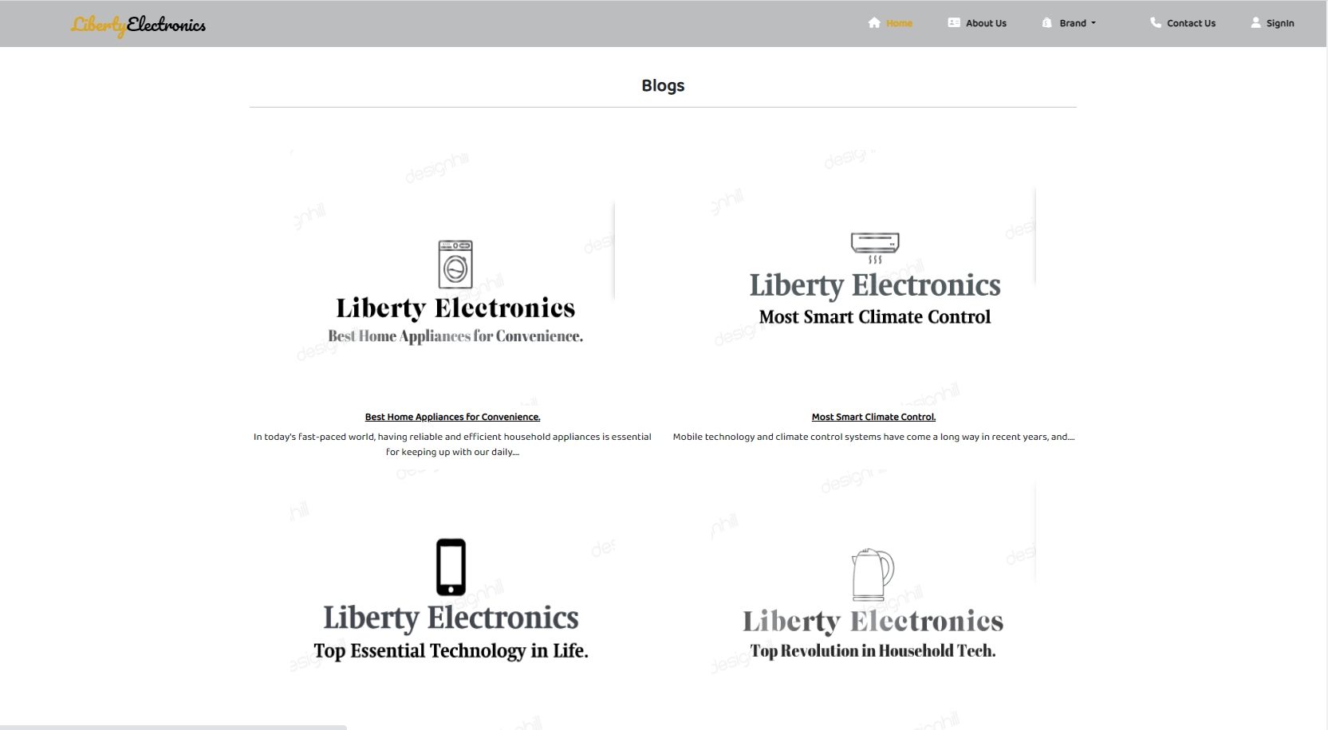
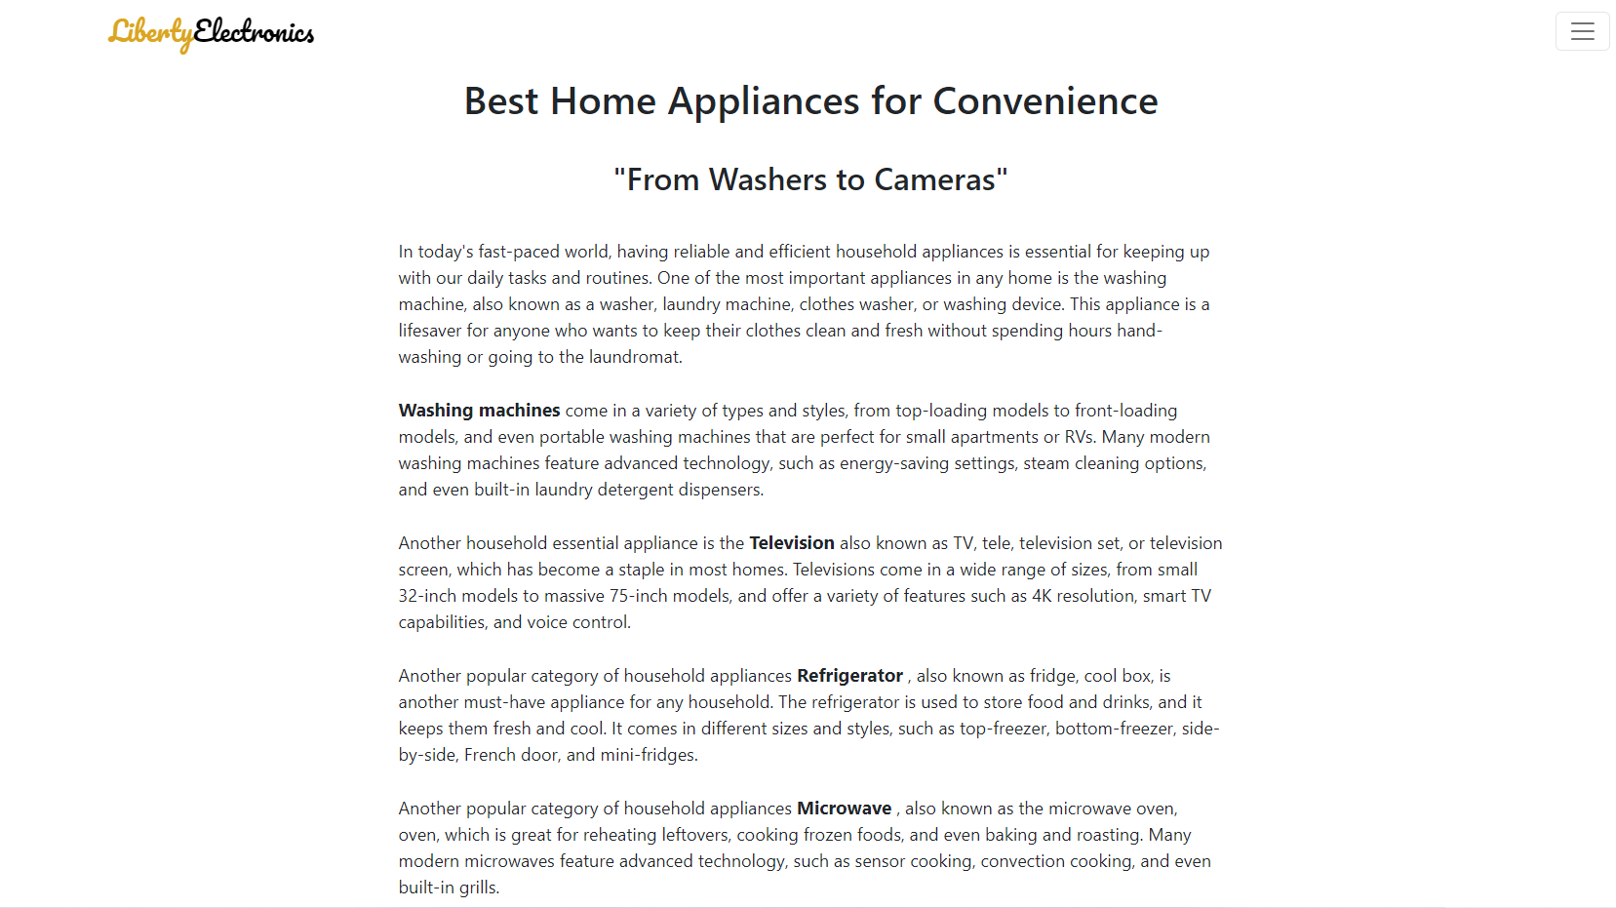
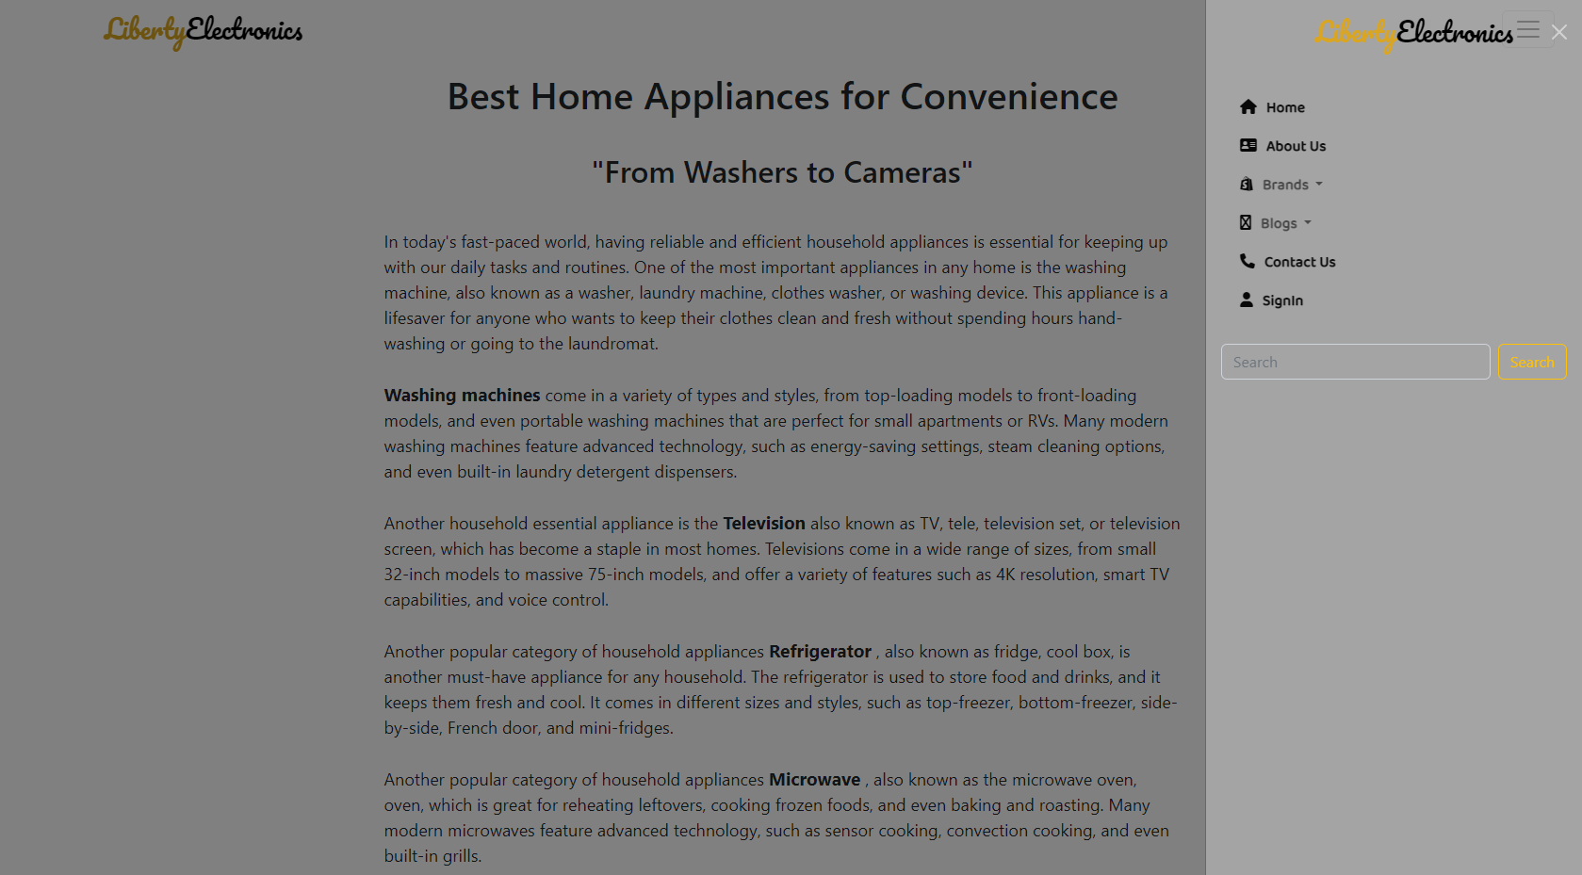
BLOG AND BLOG PAGE’S OF OUR PROJECT
Blogs
Our blog page consist our EProject topic all are information of our website inside this.
We make home blog section and official blog page in our website if user click any blog in home page then he/she will redirect to official blog page .
We will replace navbar to Off canvas in Blog page’s .
We will make blog page’s use particular Keywords like Mobile phone, cheap Mobile phone, washing machine, Refrigerators, Microwave Owen, and Many more Like this. Because it is used for SEO this key words help to searching our website of Google Search engine .

Slide 4
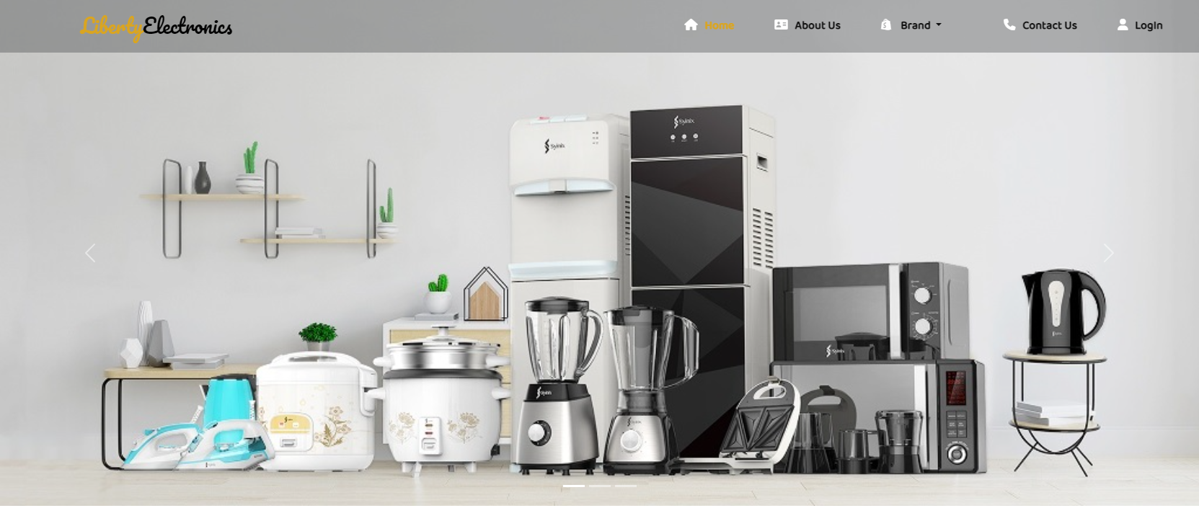
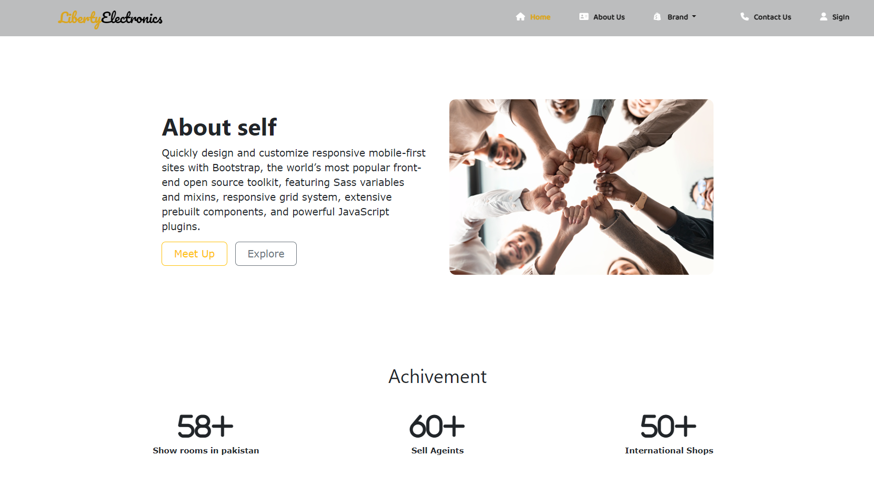
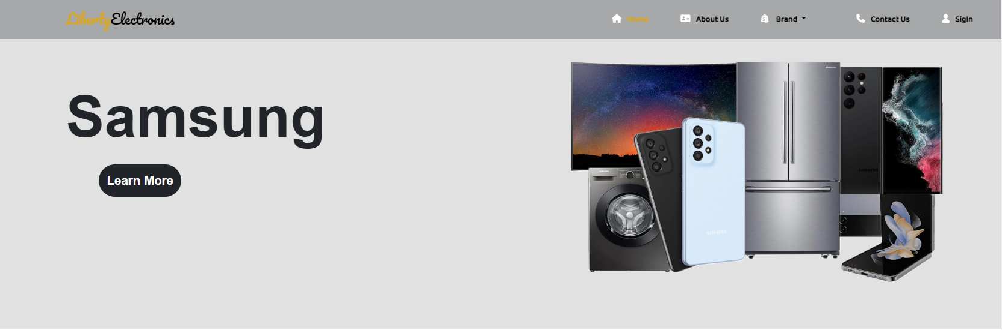
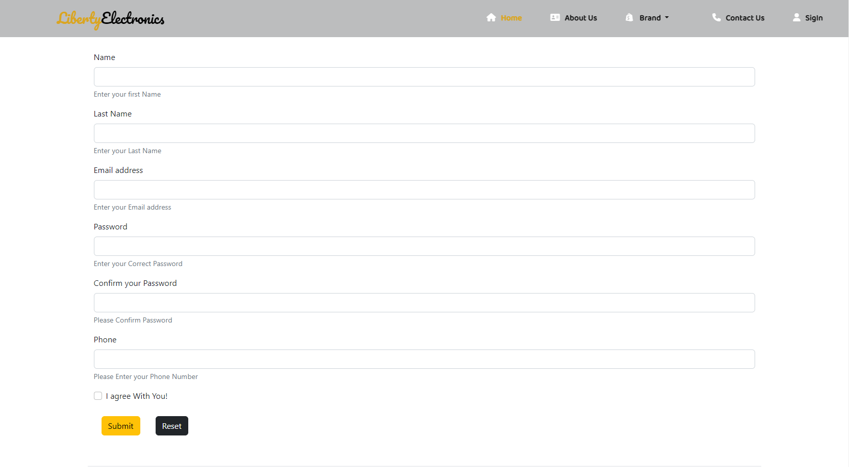
SNAP SHOTS
HOME PAGE
ABOUT US PAGE
BRANDS PAGE
CONTACT US PAGE

Slide 5
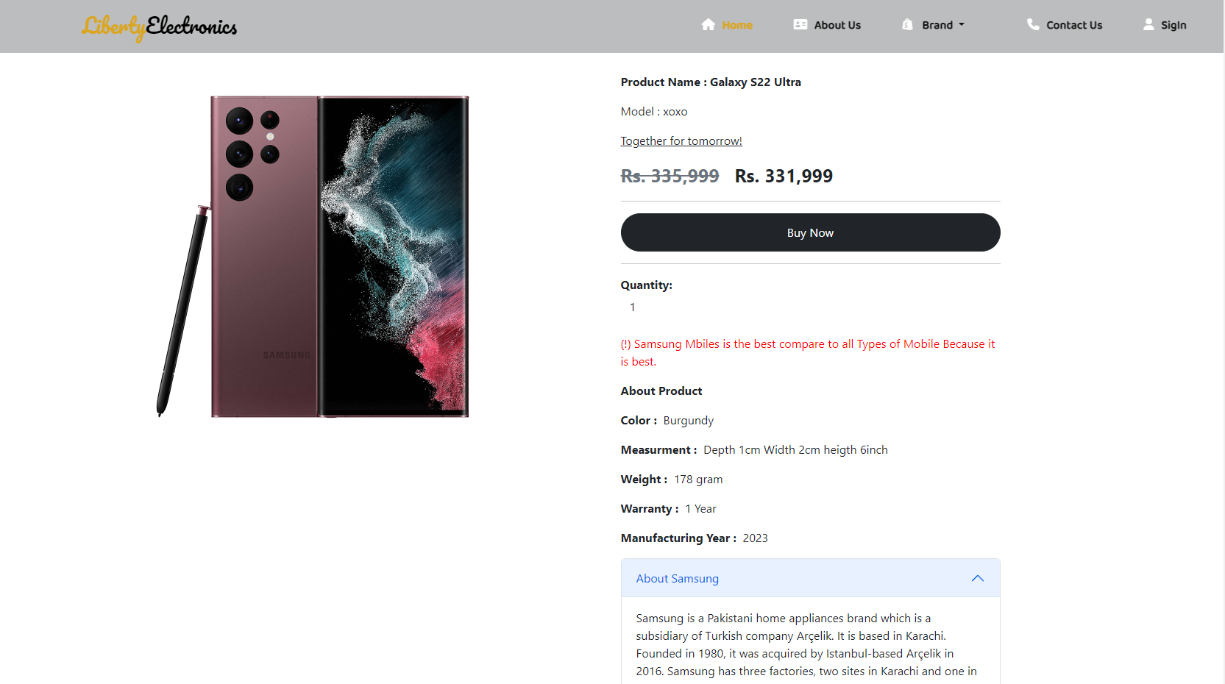
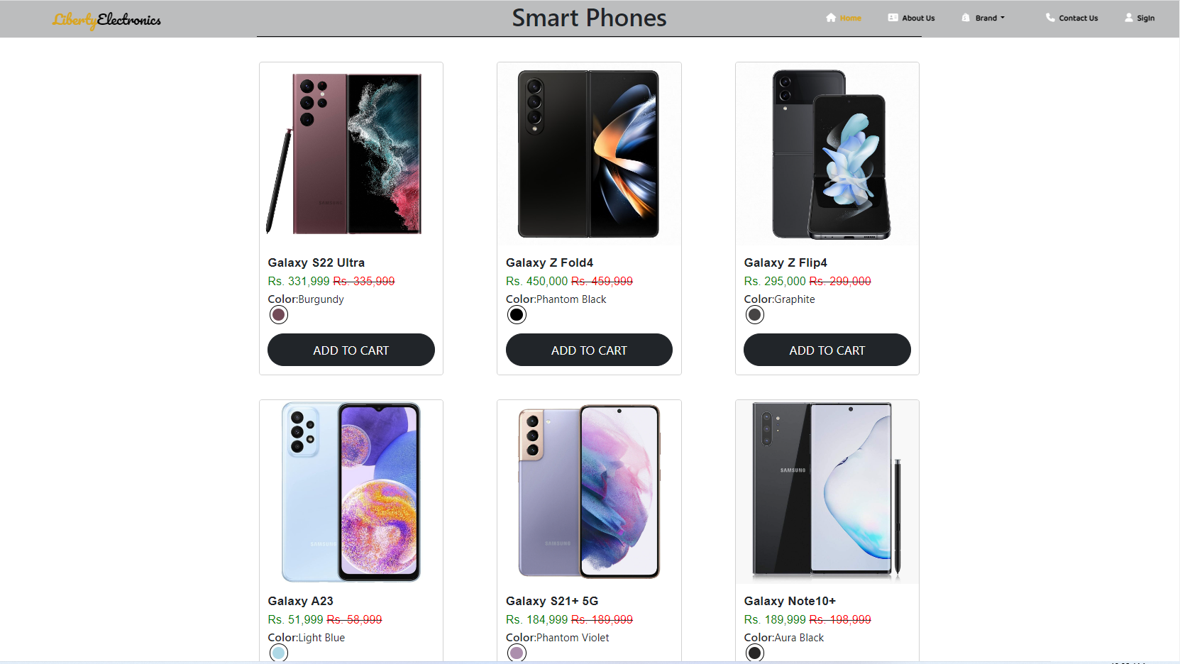
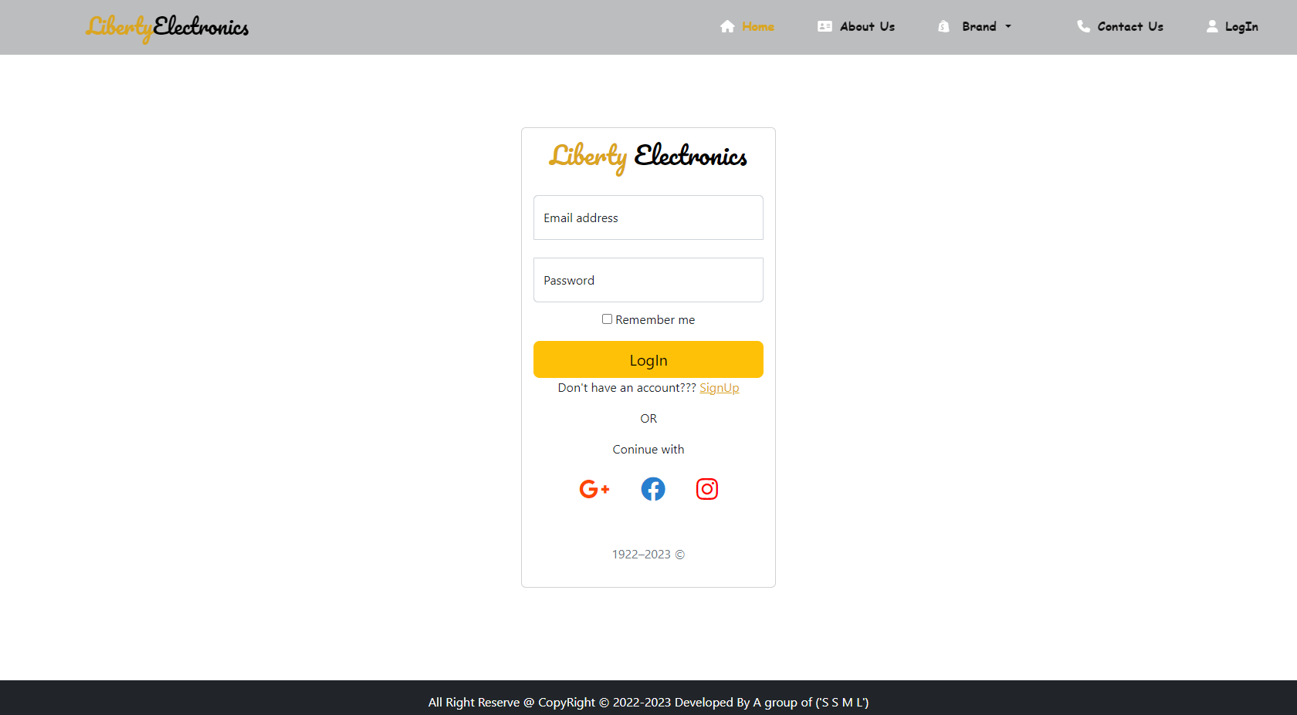
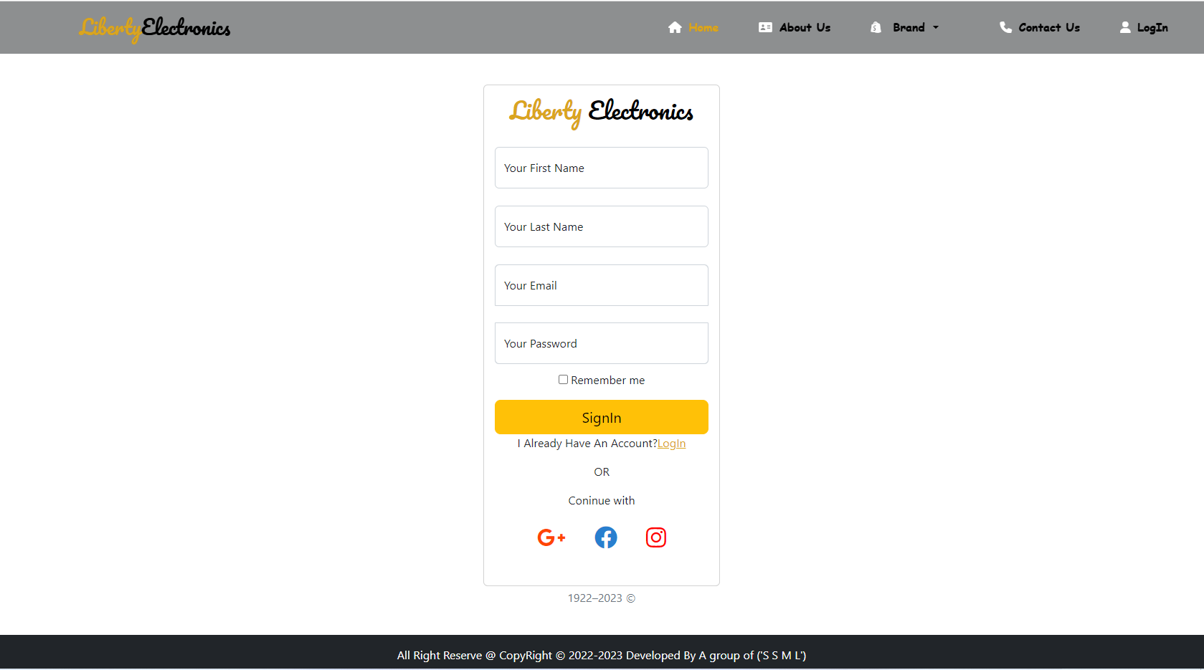
SNAP SHOTS
ONE PRODUCT PAGE
SMART PHONE BRANDS SECTION
LOGIN PAGE
SINGIN PAGE

Slide 6

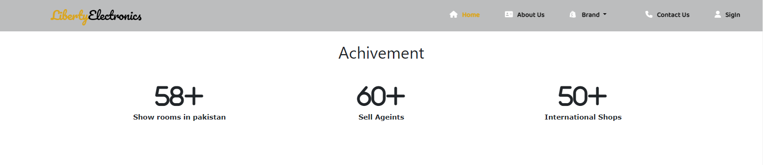
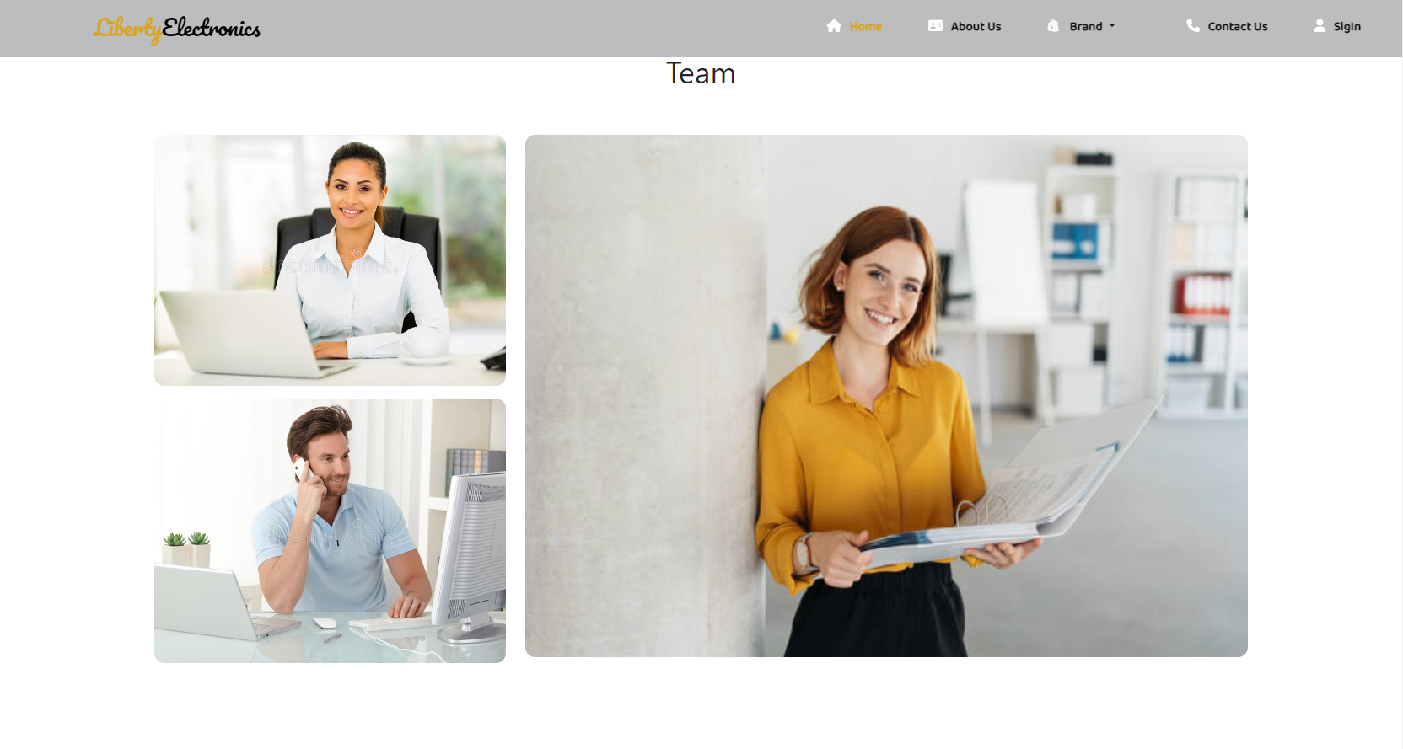
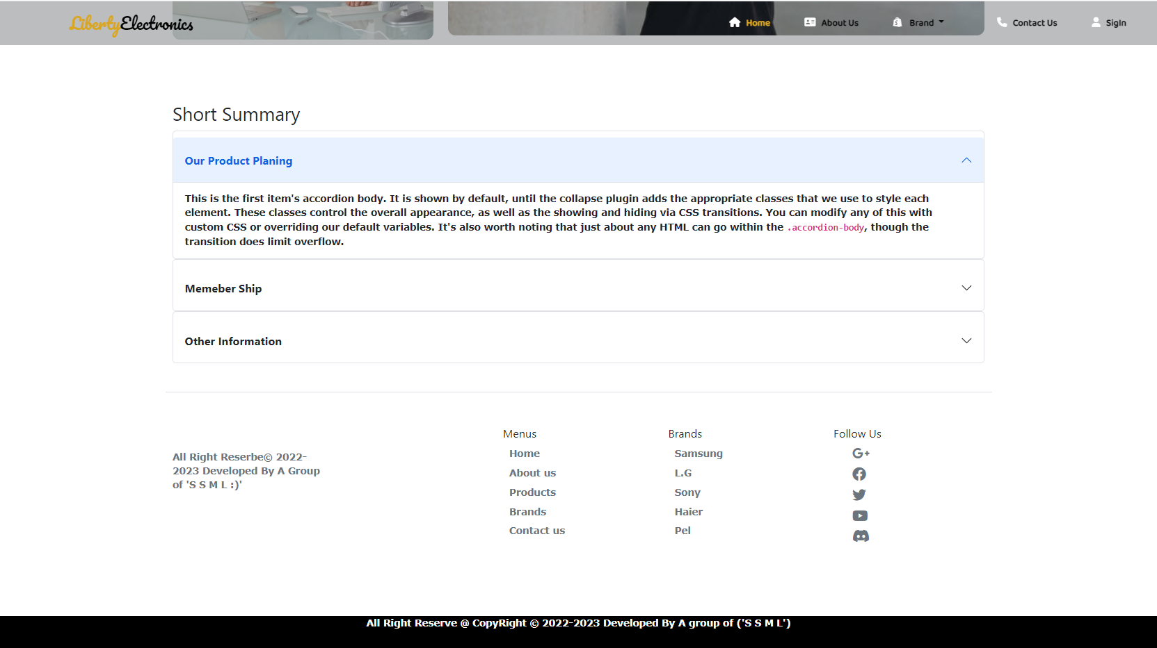
ABOUT US PAGE OF OUR PROJECT
About us page
About us page is consist of a fixed and responsive navbar with and .
After navbar we have a one grid row in this grid we have some text for our self and second we have one picture with beautiful CSS hover effect if you want to see hover effect so click on this picture.
After this grid we have an other grid row in this grid row we have same 4x md columns in this column we have some icons this icons represent our achievement and Goals and more then.
And then after this section we have a An other section for are team Members this section consist of pictures of our team members.
Then we have a Three accordion this accordion describe our story and history of are shop and products and many more..
After all section’s we have a same footer

Slide 7

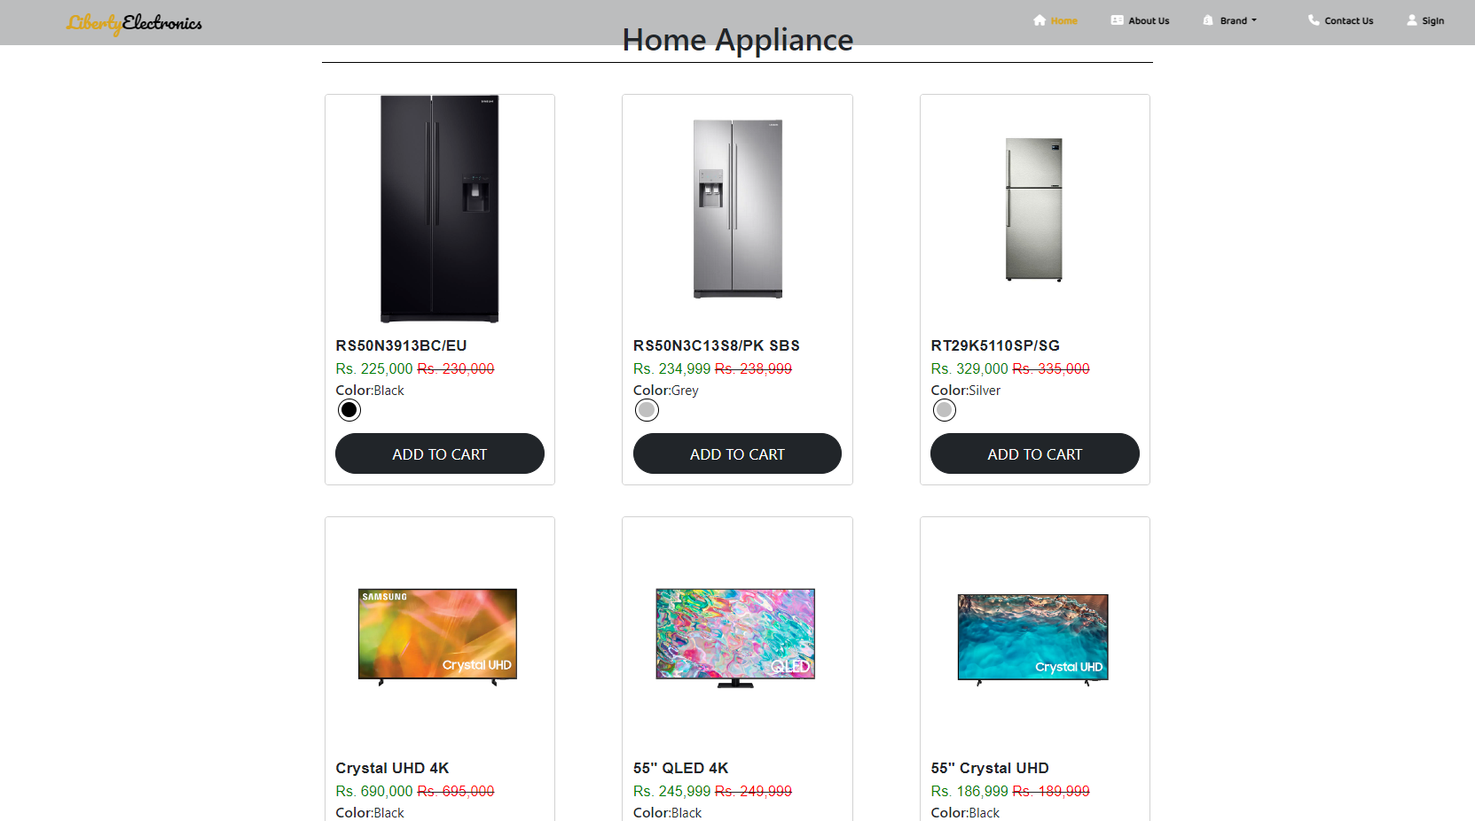
BRANDS PAGE OF OUR PROJECT
Brands and shop page
Our Brands Section consist A Lot of electronics brands Like Dawlance, Orient, Pel, Sony, And many more.
If our user click any Brand so he was redirect our brand and shop page brand page consist one product banner with brand name and its picture.
If user scroll down page then we have A lot of products of particular brands of this page like Mobile phone refrigerator hand watches washing Machin and many more items many more items in product page
If our user click any particular product item then its was redirect our one product page our this item .
Our one product page consist a same navbar of webpage and product picture with beautiful hover effect if you hover the picture.
In this page we have full information like product name , model , prize quantity and product description and one accordion in this accordion we have are provide an other information product and our website .
Then we have responsive footer.

Slide 8

CONTACT US PAGE OF OUR PROJECT
CONTACT US PAGE
This is our contact us page contact us page we have some input felids like user’s first name last name phone number Email and password and confirm password.
Contact us form have to button Submit button and reset button if you click submit button so your data was submit for our server. If user click reset button so your form was reset .
if User want to any communication so he need to fill our contact us form.
And then we have a same footer.

Slide 9

LOGIN AND SIGNUP PAGE OF OUR PROJECT
CONTACT US PAGE
Last but not least We have responsive and beautiful Login and Signup page.
If user already have an account so user also need login, Login page consist Two input field like Email and password if user fill email and password so he or she was successfully login to our website.
And if user don’t have an account so he or she need to signup, Our signup page consist Almost four input field like user first name last name email and password if user fill all field and click signup so user can be successfully signup of our website.

Slide 10
PROBLEM STATMENTS
Liberty Electronics is a shop selling various electronic products. The company advertises by distributing the pamphlets, advertising on television and so on. Due to rapid development in internet field, the company decides to launch a website where people will get all the information about the various products available with them easily.
Requirement Specification:
The Web site is to be created based on the following requirements.
The Home Page should be created making use of sections with a suitable logo
The site should display a menu which will contain the options for brief introduction about the various products available, location of the shop and any other information if required.
The information should be categorized according to the brand names of the products like if a User wants to see only Samsung products then he click on a Link/button/menu etc. and he will see only That Brand products.
When a user selects any particular brand, a list of products for that brand will be displayed
A brief summary of features of individual products should be displayed on the Web Page along with the product but detailed Features should be stored in Individual Word documents which can be downloaded or viewed by the User who wishes to see the same.
The user should also be able to compare the various products of different as well as similar brands.
There should be a “Contact Us” page which will have the Address of the Company which is as follows and the mail address which when clicked will invoke the local mail client from where they can send an email.

Slide 11
PROBLEM STATEMENTS SOLVED
We made a logo that we used in the navbar and the new made cards for the products
We used dropdown to showcase the brands. For each brand we made product’s categories
Then we made product pages for individual products where user gets to know about the individual product and he can add it to cart or we made a login and signup pages Then we made a contact us page if user want to contact he can contact throw this page by submitting their information .

Slide 12
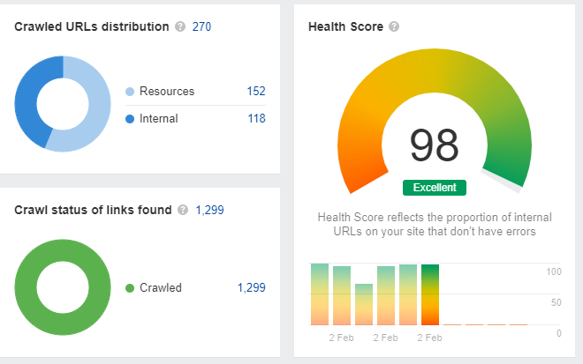
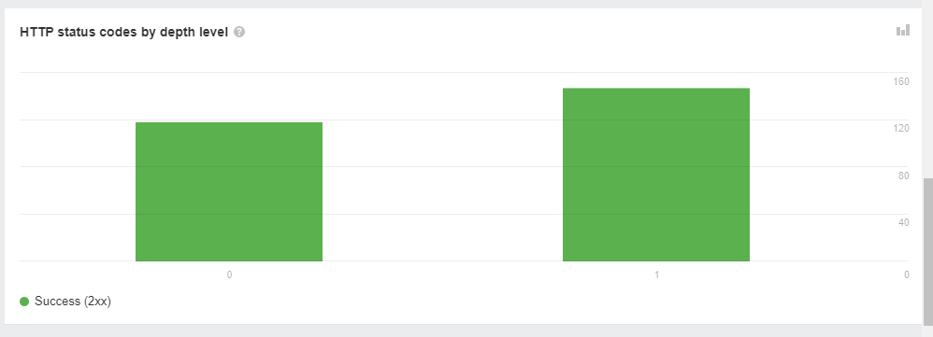
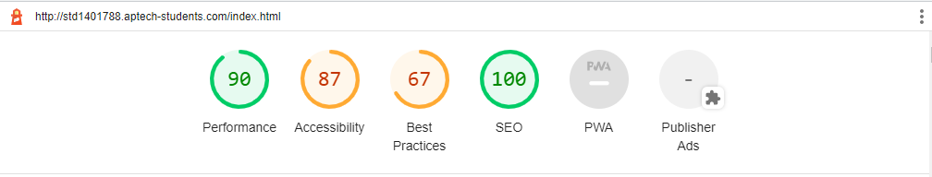
GOOGLE LIGHT HOUSE & AHREF REPORT

Slide 13

THANKS FOR WATCHING
TILL THEN KEEP LEARNING AND KEEP EXPLORING

